Slide 1
Unit 4: Iteration

AP CS A
Ms. Baniqued

Slide 2
Loops: Write Once, Repeat Many Times
A loop is a control structure that allows a set of instructions to be repeated multiple times. Like condition statements, a boolean condition is needed.
The boolean condition is not checked in the loop’s body; instead, it is tested before each interaction of the body (in a pre-test loop) or after each iteration of the loop body (in a post-test loop).
In Java, there are 3 primary types of loops: for, while, and do-while.
Pre-test loops | Post-test loops
for, while | do-while

Slide 3
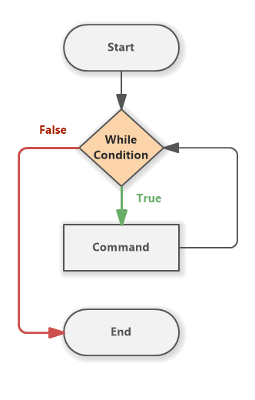
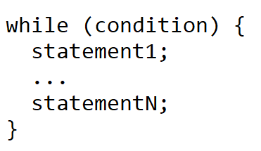
While Loop
A while loop can be used when the number of iterations is uncertain. It continues to execute a block of code as long as its Boolean condition remains true.
This condition is checked before each iteration, making it a pre-test loop.
If the condition is true, the body of the loop will execute. If the condition is false, the loop will terminate and the next line of code after the loop will execute.

Slide 4
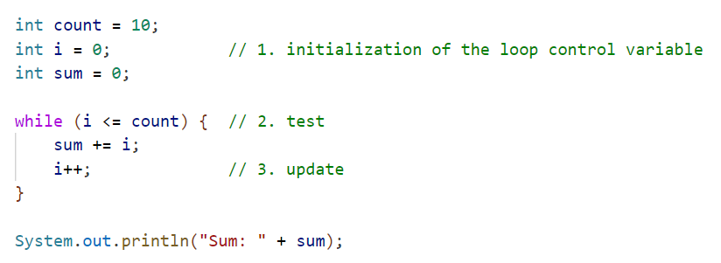
Three Parts of a While Loop
Initialization: Create and initialize a loop control variable. This variable will be used in the while condition and can be created any time in the program before the while loop header.
Test: The while condition controls how many times the loop will execute. This is in the while loop header.
Update: The loop control variable must be updated in the body of the while loop, otherwise the loop will never terminate, creating an infinite loop.
After loop: This statement is executed after the loop has terminated.
Note: A pre-test loop might not execute. For example, if count is initialized to -1, the program will never enter the body of the while loop. It will jump straight to the line of code following the loop.

Slide 5
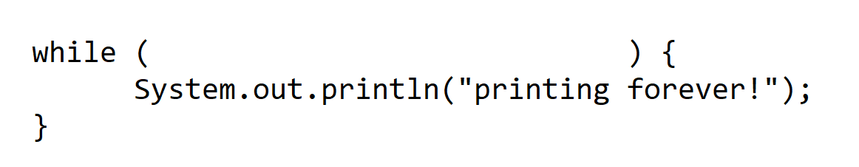
Infinite Loops

Slide 6
Infinite Loops

Slide 7
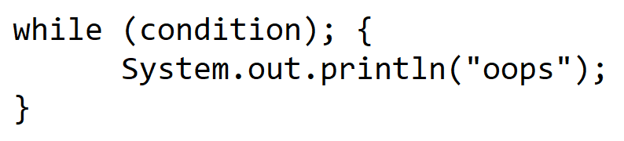
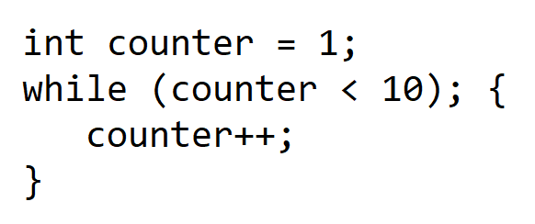
More Infinite Loops

Slide 8
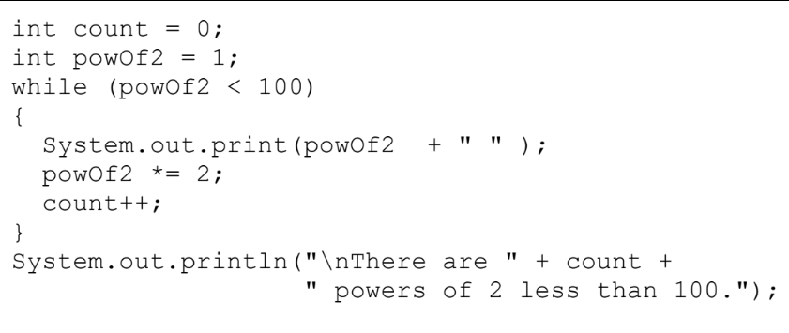
Tracing a While Loop with a Table
count | powOf2 | powOf2 < 100
0 | 1
Output: There are _______________ powers of 2 less than 100.

Slide 9
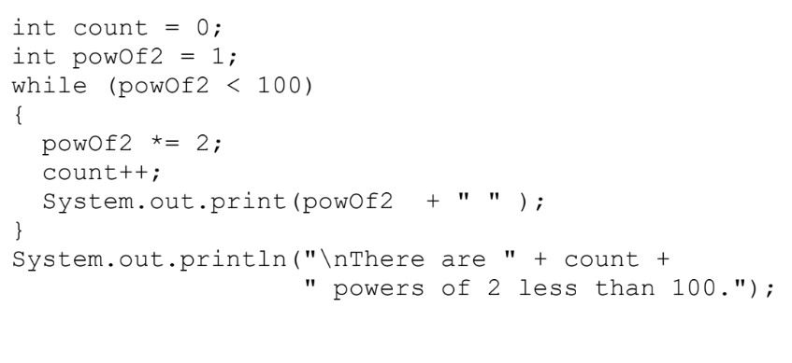
Tracing a While Loop with a Table
count | powOf2 | powOf2 < 100
0 | 1
Output: There are _______________ powers of 2 less than 100.

